Slide 1
Electronics 1 Homework 2 from chapter 5
Mark Maddox
Electrical Engineering Program
University of Central Florida
mark.maddox2@ucf.edu
mark.maddox@analog.com

Slide 2
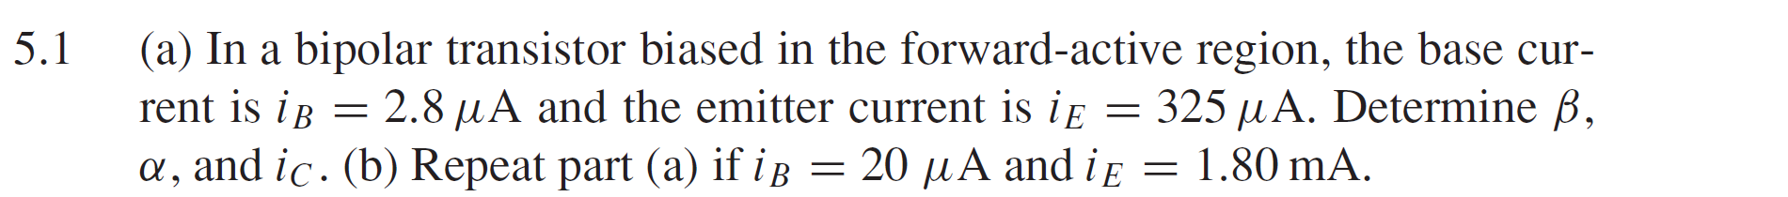

Slide 3
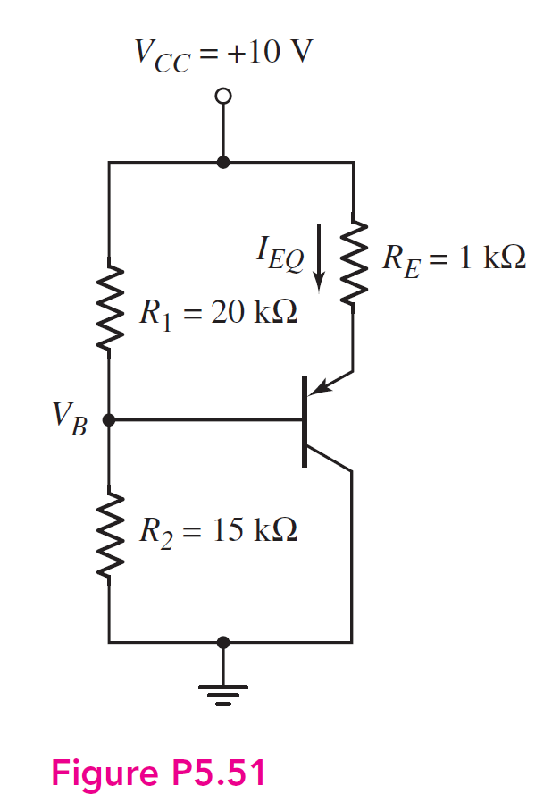

Slide 4
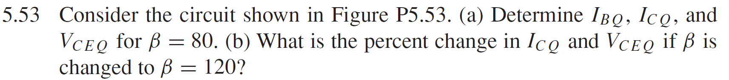
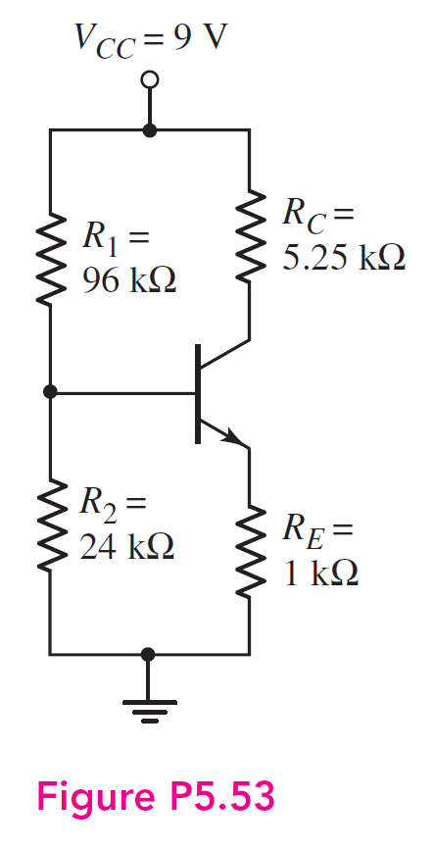

Slide 5
